Slide 1
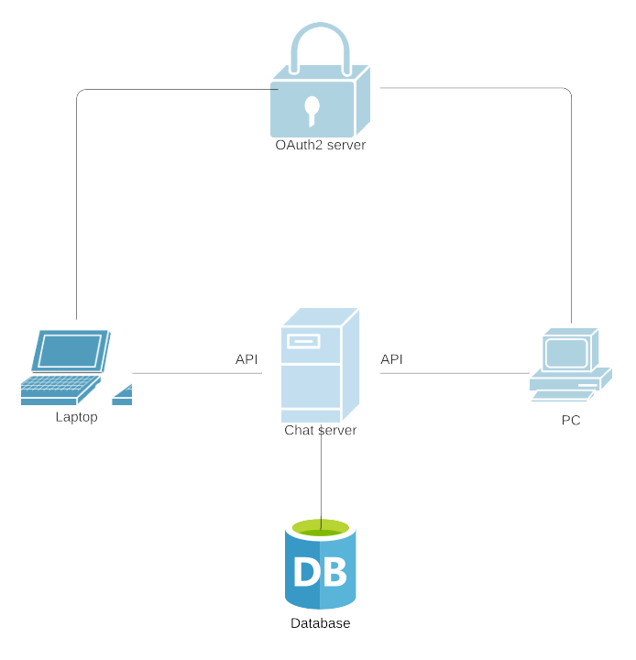
[Project TITLE or TEAM NAME]
Concept
Current Status and Next Steps
Expected Outcome
Planning done
Starting with implementation
Github repo set up
Chat application with secure authorization/authentication

